Slide 1
Umpire Communications – Verbal & Non Verbal
Notes:
We are now going to look at how Umpires Communicate both verbally and non verbally.

Slide 2

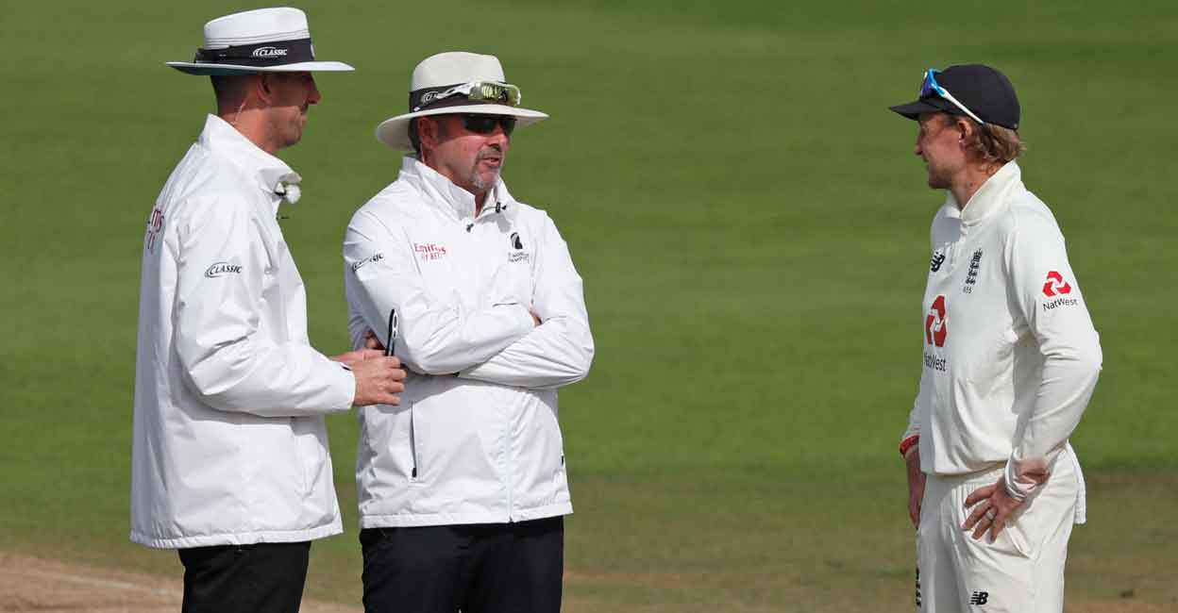
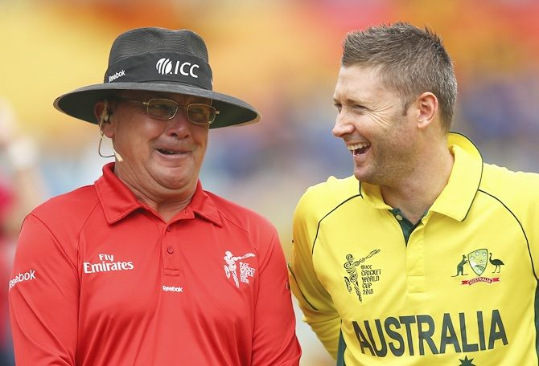
Sometimes difficult to find a way to reach a player.
Research suggests that how players react to your decisions is based on what they think of you!
Notes:
We have all experienced difficulties in reaching players, that is because everyone is different. Something we should all note is that research has shown that players reactions to your decisions is not based on the decisions themselves but what the player thinks of you.

Slide 3

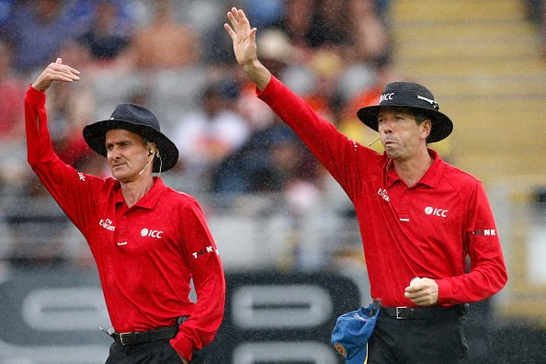
What do players want of an umpire?
Competent & Fair
Dependable
Respectful
Smartly Dressed
Smart Decisions
Notes:
So, what do players want of an umpire – lets look at them in no particular order

Slide 4
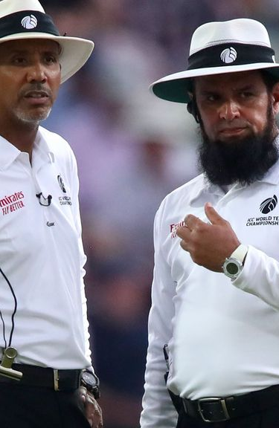
One Way Communications or how you present yourself
Physically Relaxed
Assured & Confident
Verbally – Clear,
Accurate & Concise
Notes:
So what is the best way to present yourself? Show 3 Physically Relaxed, Assured & Confident, Verbally – Clear Accurate & Concise. We have an ECB video coming up and these points will be well illustrated.

Slide 5
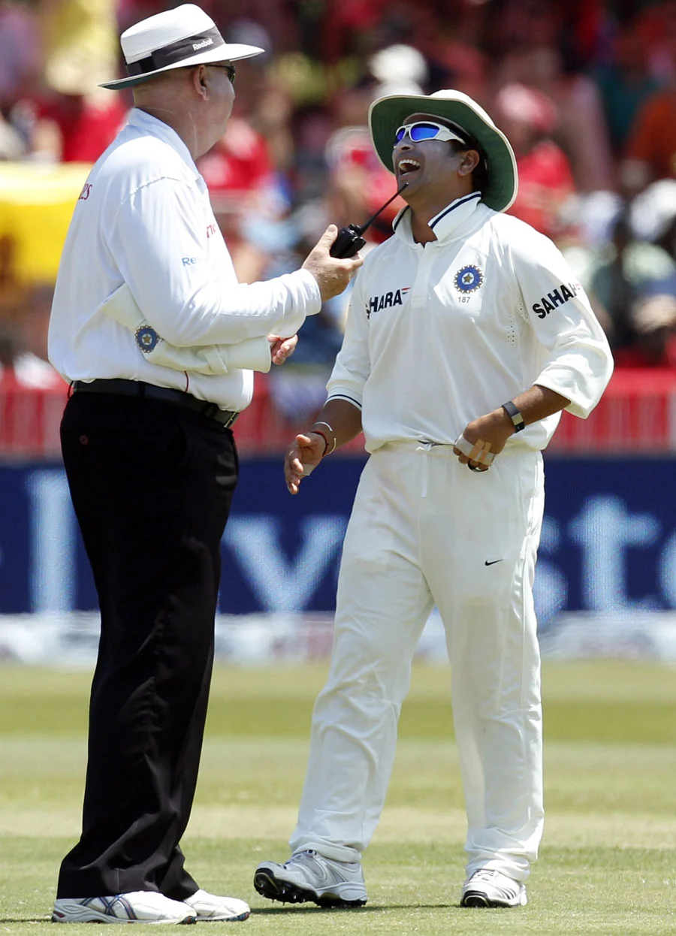

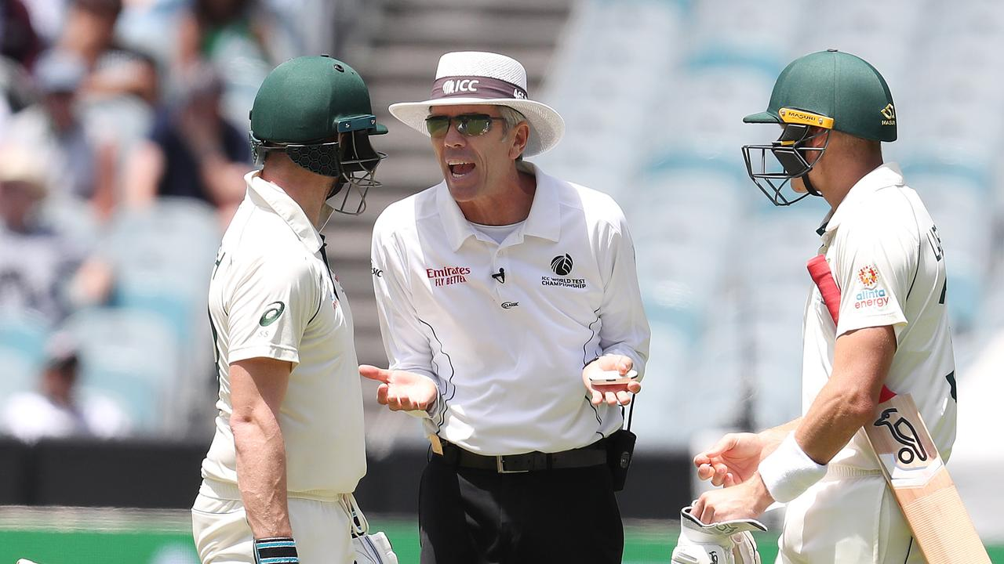
Umpire - Personal Qualities
X
Domineering
Dismissive
Dictatorial
Arrogant
Overly Familiar
Respectful
Polite
Courteous
Collaborative
Approachable
Friendly
Fair
Show Integrity
Show Humility
Not overly Assertive
Not overly Authoritative
Treat Players as Equals
Notes:
Go through list (they come up one at a time). Then put-up in one go things the official should not be. There will be crosses that come up on a click to show they should not be used. End with “Treat Players as Equals”.

Slide 6
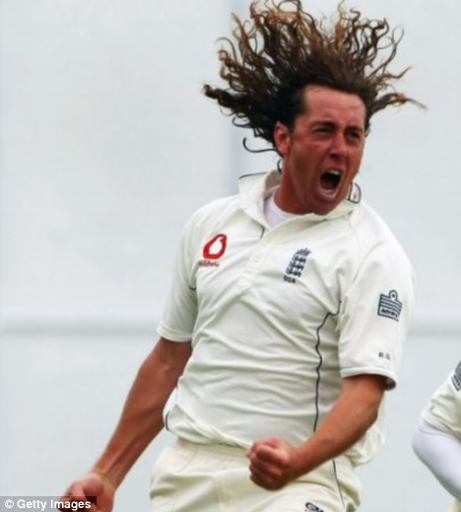

Situation Monitoring – “Emotional Intelligence”
Ability to read player’s intentions, emotions and behaviour displays and how it changes through the match.
Barometer for the status of the game.
How intent things are and how players are feeling.
Notes:
Talk about “Situation Monitoring” gaining Emotional Intelligence as you officiate the match. Read players and handle accordingly. Think of it as barometer for the status of the game.

Slide 7
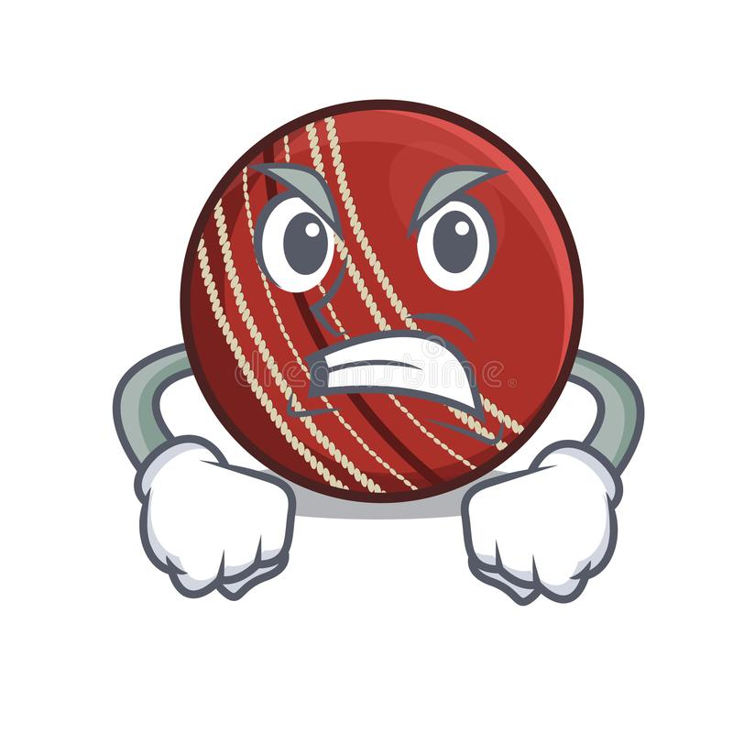

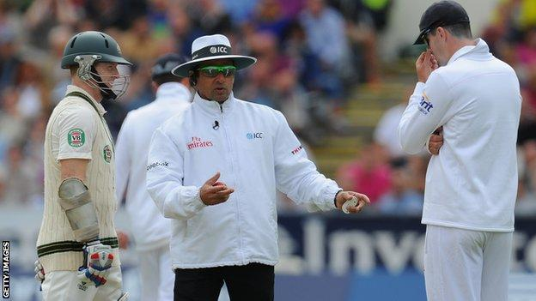
How do you handle things?
Skilled Inter- Action
Be Heard
Be Fair and Equitable
Players Vary they need Different Managing…..
Take control of the situation!
Notes:
As the audience to consider how they handle things? Have they developed their skills to ensure that they are heard, they are fair and equitable, that they adapt to managing players differently and above all do they take control of the situation.

Slide 8
Be aware of the importance of voice tone.
Video Summary
Verbal & Non Verbal Communications should complement each other.
Smiling, Neutral, Relaxed
Open
Close, Facing
Open
Up
Good contact
Slow, calm, strongb
Face -
Posture -
Proximity -
Hands -
Head -
Eyes -
Movement -
Notes:
Research suggests that how players react to your decision is based on what they think of you! We have looked at how you can improve your verbal and non-verbal communications. Ensure Verbal & Non Verbal Communications complement. If you give off the right non-verbal signals of being relaxed, assured and confident back up with good verbal skills that are polite, respectful and friendly and you should stay away from taking on a domineering, dictatorial approach.
These are skills that some officials find natural and easy whilst others of us have to work at it to get it right and we will with experience. In particular we should work on our Situation Monitoring (Emotional Intelligence) by reading players emotions and how they are changing. Experience will tell us how to react at each stage such as quiet word, humor perhaps. Be prepared though that works on one occasion with a player will not necessarily work as well or at all with another player in another match situation.

Slide 9
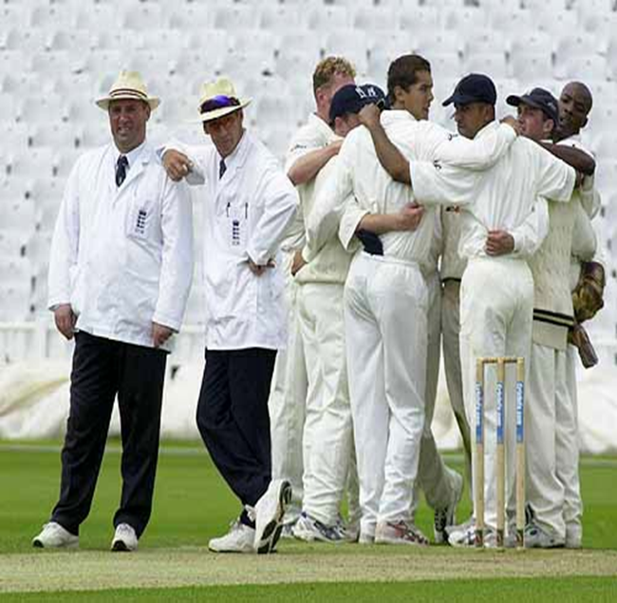
Summary
Look to improve your verbal and non-verbal communications
Skilled Inter- Action
Refrain from being domineering and dictatorial
Learn from experience and evaluate your own man and match management
Notes:
We have learnt that research suggests that how players react to your decision is based on what they think of you! We have looked at how you can improve your verbal and non-verbal communications. If you give off the right non-verbal signals of being relaxed, assured and confident back up with good verbal skills that are polite, respectful and friendly and you should stay away from taking on a domineering, dictatorial approach.
These are skills that some officials find natural and easy whilst others of us have to work at it to get it right and we will with experience. In particular we should work on our Situation Monitoring (Emotional Intelligence) by reading players emotions and how they are changing. Experience will tell us how to react at each stage such as quiet word, humor perhaps. Be prepared though that works on one occasion with a player will not necessarily work as well or at all with another player in another match situation.

Slide 10
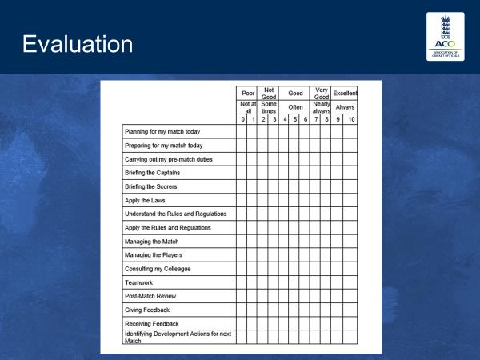
Notes:
We never stop learning and a good way of self appraising is to use a personal evaluation form such as this one. Thank you. Do you have any questions?

